Slide 1

LICENSED MIDWIVES
in New York State

Slide 2
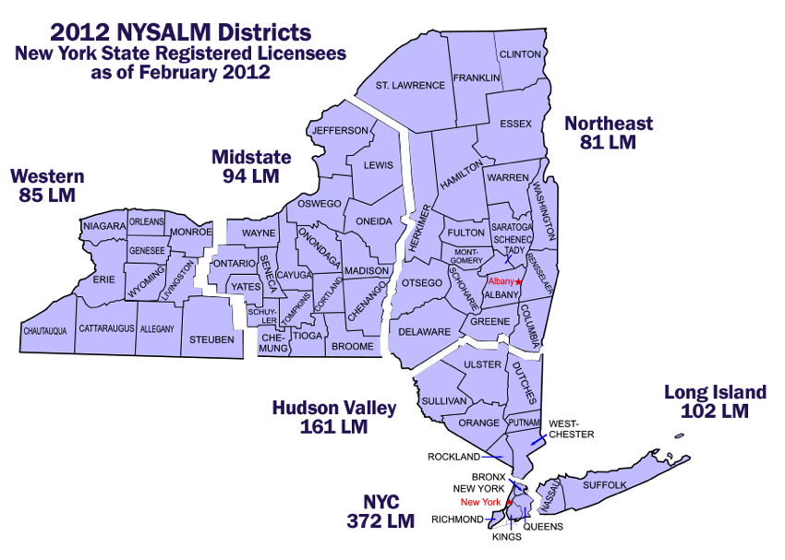
What is NYSALM?
New York State Association of Licensed Midwives (NYSALM): The voice of Midwives in New York
Notes:
Comments:
NYSALM is a group of practicing Licensed Midwives from around NY State who came together in 2000 and created an organization that would meet the needs of midwives providing care in each type of practice setting. The goal was to create an organization that could speak with one voice to legislators, insurers, and other healthcare organizations of professionals to create collaborative relationships intended to improve the health of women, families, and the state through improving access to midwifery services.

Slide 3
True or False?
Midwives deliver babies in hospitals, birth centers, and in homes?
  TRUE
Midwives and doulas provide the same care?
  FALSE
Midwives may prescribe medications?
  TRUE
Midwives are licensed to practice independently?
  TRUE
Midwives attend only births?
  FALSE
Licensed Midwives must also hold an RN license?
  FALSE
Notes:
Comments:
TRUE. In NY State most LM’s attend births in hospitals as most babies are born in hospitals. However, many LM’s attend births in birth centers and in client homes. Midwives are broadly integrated into the healthcare delivery system.
2. FALSE. Midwives and Doulas have different roles in obstetric care. Midwives are licensed healthcare providers that are state regulated. Doulas are support personnel that provide emotional support during the childbearing cycle. Doulas are not licensed or regulated by the state and therefore cannot engage in direct patient care.
3. TRUE. In NY State, LM’s have full prescriptive authority which means they have the ability to prescribe both controlled and non-controlled medications including birth control, pain management medications and labor induction agents. In addition, LM’s have the ability to independently prescribe and administer immunizing agents, laboratory tests, and other screening and diagnostic tests.
4. TRUE. Midwives are licensed independent health care providers that carry malpractice insurance. Many LM’s have independent admitting and discharge privileges in hospitals. LM’s are not supervised by physicians.
5. FALSE. Midwives provide full scope primary care for women during the life course. In addition to maternity care, midwives provide gynecologic care (adolescence through menopause), family planning, primary care, and newborn care. NY State requires health care insurance plans and Medicaid to cover midwifery care services.
6. FALSE. NY State law does not require nursing degree or licensure to practice as a midwife. Many midwives in New York State have backgrounds in other fields, for example PAs, nutritionists, massage therapists, etc.
Source: http://www.op.nysed.gov/prof/midwife/midwifeqa.htm

Slide 4

What defines midwifery care?
~ Care of women throughout life
~ Approach that supports each women’s physical, psychological, and social well- being
~ Consideration that pregnancy, birth, and menopause are normal life processes
~ Personalized care that is evidence-based
Notes:
Personalized care means:
Treating women as active partners in their own health care;
Individualized education, counseling, and prenatal care;
Hands-on assistance during labor and delivery;
Postpartum support including breastfeeding.
Evidence-based means:
Appropriate use of technological interventions;
Identification and referral of women who require medical attention.
Sources:
http://cfmidwifery.org/mmoc/define.aspx Copyright (c) 1996-2008, Midwifery Task Force, Inc., All Rights Reserved.
http://www.who.int/features/factfiles/midwifery/en/
www.birthtools.org

Slide 5
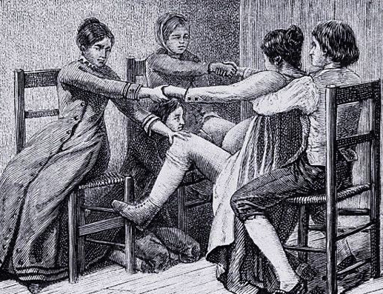
Women managed with a midwifery model are:
19% less likely Cesarean birth
19% less likely to use regional anesthesia
14% less likely instruments at birth
18% less likely episiotomy
10% less likely preterm delivery
More likely to breastfeed
More likely to report satisfaction with care
Notes:
Lily wrote Stacey for clarification about bullet point 1 on 8/22
Comments:
The literature supports improved outcomes, costs, patient satisfaction and no increased risk to infants when patients are managed within a midwifery model.
Midwives achieve these outcomes through time spent with patients on education including: risk reduction, prevention strategies, counseling, developing trust and improving communication.
Midwives address patients as holistic beings body, mind and spirit- we often address nutrition, mental health issues and social issues that are important to maternal health.
Midwifery care lowers cesarean sections (14% vs. national rate of 33% in 2011)
Midwifery care lowers preterm delivery (2% vs. national rate of 12% in 2011)
21% less likely to have a fetal loss before 24 weeks
Vaginal birth is more cost-effective and uses fewer resources in general.
Studies have shown that patient satisfaction is higher with midwifery-managed or midwifery-based care in both a triage setting and through labor and delivery. The Affordable Care Act ties patient satisfaction survey scores to Medicaid/Medicare reimbursement.
“What works is not flashy, not expensive, but it’s human intensive.” - Heidi Rinehart, Amnesty International Interview 2008
Sources:
Medical outcomes:
ACNM, “Midwifery: Evidence-Based Practice,” April 2012: http://www.midwife.org/ACNM/files/ccLibraryFiles/Filename/000000002128/Midwifery%20Evidence-based%20Practice%20Issue%20Brief%20FINALMAY%202012.pdf
Cochrane Library http://onlinelibrary.wiley.com/doi/10.1002/14651858.CD004667.pub3/abstract
ACNM Benchmarking Project http://www.midwife.org/benchmarking
ACNM BirthTools: http://birthtools.org/Focus-on-Physiologic-Birth-2
Patient satisfaction:
http://www.usatoday.com/story/money/business/2012/12/24/hospitals-satisfaction-surveys-medicare/1788833/
Paul J, Jordan R, Duty S, Engstrom JL. Improving satisfaction with care and reducing length of stay in an obstetric triage unit using a nurse-midwife-managed model of care. J Midwifery Womens Health 2013;58(2):175-81.
Harvey S, Rach D, Stainton MC, Jarrell J, Brant R. Evaluation of satisfaction with midwifery care. Midwifery 2002;18(4):260-7.
http://onlinelibrary.wiley.com/doi/10.1002/14651858.CD004667.pub3/abstract

Slide 6
Midwifery Demographics in NYS
New York has 1094 licensed midwives ~ the largest group nationally
~ 400 midwifery practice sites
~103 hospitals
~two free-standing birth centers
~many clinics and private practices
10% of all babies in NYS are delivered by midwives. More than 50% of these births are covered by Medicaid
Notes:
Comments:
Midwives deliver about 10% of babies born in NYS – 15% of all vaginal deliveries. In 2012, that was 23,000 (NYS DOH, 2012 data, table 4)
Less than 1% of births in New York State are planned homebirths. (Source: Karen Jefferson)
Sources:
1. Midwives and Ob/Gyns per 1,000 births, OECD Countries, 2006, OECD Health Data 2009
2. “HELP Wanted: New York’s Physician Shortage Continues to Worsen” – HANYS 2010 Physician Advocacy Survey
3. Martiniano R, Siwach G, Krohl D, and Smith L. New York State Health Workforce Planning Data Guide 2013. Rensselaer, NY: Center for Health Workforce Studies, September 2013. http://chws.albany.edu/
4. ACNM Powerpoint, “Understanding your practice environment: making an informed decision about where to work”
5. Number of licensed midwives – personal communication with Tim, Clerk 1 at NYS DOE, 6/6/14: stats as of 12/31/13: 931 with addresses in NYS, 158 with addresses out of state, 5 with foreign addresses
6. Number of licensed homebirth midwives – counted by Karen Jefferson 2/7/14

Slide 7
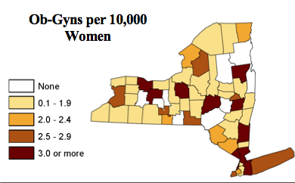
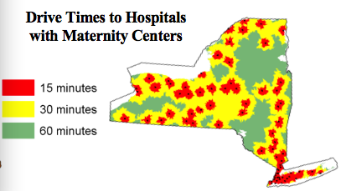
NY State Needs More Midwives
9 counties have no obstetricians and 5 have no midwives
2 counties have NO obstetricians OR midwives
NYS has a shortage of maternity care professionals, particularly in rural areas and inner cities
Per 100,000 people in NYS, there are 14 obstetricians and 76 NPs/midwives
Images used with permission from ACOG
Notes:
Comments:
-NYS continues to be challenged by retaining trained women’s health providers for a variety of reasons including malpractice insurance costs. Liability concerns, attrition in the medical profession...
44% of respondents to a 2010 survey conducted by the Healthcare Association of New York State (HANYS) reported that Ob/Gyns were very difficult to recruit.
-Counties w/ no midwives: Hamilton, Ontario, Seneca, Montgomery, Lewis
-Counties w/ neither OB nor midwives: Hamilton and Seneca
Sources:
HANYS, “Help Wanted: New York’s Physician Shortage Continues to Worsen,” 2010, http://www.hanys.org/communications/publications/2011/2011-01-10_physician_survey_results_2010_electronic.pdf
Health Workforce Planning Data Guide, Center for Health Workforce Studies, 2013, http://chws.albany.edu/archive/uploads/2013/09/nys_health_workforce_planning_data_guide_2013.pdf
http://www.acog.org/~/media/Departments/Government%20Relations%20and%20Outreach/WF2011NY.pdf
GRAPHIC SOURCE: 2014 ACOG workforce fact sheet http://www.acog.org/~/media/Departments/Government%20Relations%20and%20Outreach/WF2011NY.pdf
Images are from ACOG workforce graphic

Slide 8
Midwife Alphabet Soup
The 3 steps to become a midwife in New York State:
EDUCATION
CERTIFICATION
LICENSURE
Leads to being a Licensed Midwife.
CM
MSN
LM
PhD
DNP
SM
MS
CNM
GM
Notes:
We are all LMs in New York State.

Slide 9
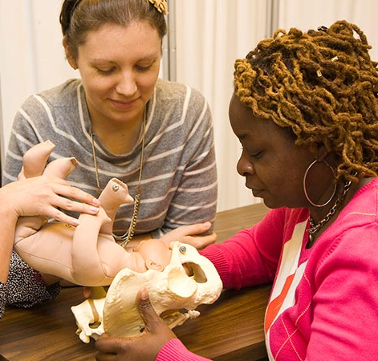
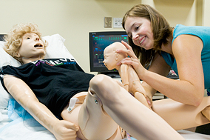
EDUCATION
Notes:
Comments:
Since 2011, minimum educational requirements for licensure has been a masters’ degree. Prior to that point, there were multiple entries to practice.
Four midwifery programs in the Empire State: SUNY Stony Brook, SUNY Downstate, New York University, Columbia University.
SUNY Downstate is the only one that does not require nursing degree as prerequisite to either matriculation or graduation. The DOE does not require nursing as a prerequisite. Midwifery education includes same components for all students: pharmacology, research, well-woman care, primary care, prenatal, intrapartum, postpartum, and newborn care.
To get a NYS midwifery license, midwives must graduate from educational programs that are registered by the NYS State Department of Education or determined by the DOE to be equivalent.
SM = student midwife. GM = Graduate Midwife

Slide 10

CERTIFICATION
Notes:
Comments:
CM = Certified Midwife
CNM = Certified Nurse Midwife
Both CMs and CNMs take the same licensing exam, currently administered by the American Midwifery Certification Board (AMCB)
As a requirement to receiving a license New York State requires midwives to pass a state licensing exam, which currently is the AMCB exam.
Because NYS uses the AMCB exam as the state licensing exam, certification is often conflated with licensure. However, if NYS changed the exam it uses, midwives in NYS could be required to take two exams – one for licensure and one for certification.
Most hospitals require the certification but it is not required for licensure.

Slide 11

LICENSURE
Notes:
Comments:
NYS midwife license is the only document that gives midwives the right to legally practice in New York State.
We are all LMs in New York State
As of 2012, NYS has licensed more than 1000 midwives – more than any other state. (Personal correspondence with NYS DOE 6/6/14 –dplsdsu@mail.nysed.gov)
License requirements:
-master’s degree
-training in pharmacology and primary care
-passing AMCB certification exam
The Board of Regents and the State Education Department oversee licensure & practice of midwifery in NYS – along with 49 other licensed health/business/design professions.

Slide 12
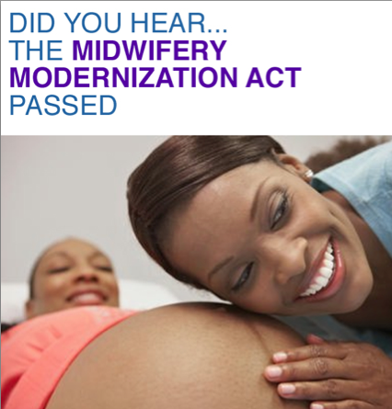
Independent Providers in NYS
1992 Midwifery Practice Act licensed the profession and established a Board of Midwifery
2010 Midwifery Modernization Act removed the requirement for a signed written practice agreement between midwives and physicians
All insurance companies under jurisdiction of NYS insurance department must cover midwifery services for maternity care
!!!
Notes:
Comments:
MMA removed WPA between midwives and physicians as a precondition to practice or reimbursement.
This ensures seamless access to care for women and families while protecting physicians working with midwives from undue exposure to liability.
NYS law requires all insurance companies under the jurisdiction of the NYS insurance department or the NYS Office of Managed Care to include midwifery services for the provision of maternity care. (NYS Insurance Law – section 4303(c)
If an insurance company does not include licensed midwives in their provider network, they must reimburse for maternity services provided by a licensed midwife even if there is no out-of-network provision.
ERISA is a federal law that exempts self-funded health and other benefit plans (employer and union) from state jurisdiction. These plans are governed by the U.S. Department of Labor.
Medicare and Medicaid both provide coverage for midwifery services.

Slide 13
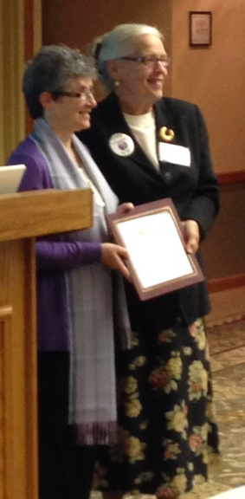
Improving Outcomes
Midwives ensure safe outcomes through evidence based practice
Midwives collaborate, co-manage, and sometimes refer patients to a physician as the safety and well-being of the patient is paramount
The result is a collegial healthcare environment with improved patient satisfaction
Notes:
Comments:
Collaboration = “to labor together”
Picture is of Ob/Gyn Ellen Biggers receiving an award from NYSALM President Pat Burkhardt for her work on collaborative relationships between midwives and MDs
Midwifery professional expectations include assessment of when a patient’s needs fall outside our scope of practice, in which case we consult, collaborate, or refer just as all health professionals do.
Patients in collaborative practices obtain appointments more quickly, spend more time with providers, and receive more health information.
Possible collaborators include: other midwives, licensed physicians of any specialty, pediatricians, neonatologists, family practice physicians, anesthesiologists, psychiatrists, radiologists, primary care providers, nutritionists, social workers, chiropractors, acupuncturists, physical therapists, nurse practitioners.
Midwives maintain documentation of collaborative relationship, for example:
-charting when midwives communicate with collaborators
-providing patients with educational documents that include the plan for emergency medical/gynecologic/obstetrical care
-documented mechanisms for patient transfer (when midwives work out of the hospital)
Source:
1. Jackson 2003, Hankins 1996 via ACNM Pearls

Slide 14

Questions?
To contact NYSALM:
newyorkmidwives@gmail.com
518-852-7965

Slide 15
References
American College of Nurse Midwives (2012). A summary of research of midwifery practice in the United States. Retrieved August 15, 2014 from http://www.midwife.org/ACNM/files/ccLibraryFiles/Filename/000000002128/Midwifery%20Evidence-based%20Practice%20Issue%20Brief%20FINALMAY%202012.pdf
BirthTOOLS.org (2014). Tools for optimizing the outcomes of labor safely. Retrieved August 15, 2014 from http://www.birthtools.org/
Citizens for Midwifery (2014). The midwives model of care. Retrieved August 15, 2014 from http://cfmidwifery.org/mmoc/define.aspx
Lancet(2014). Midwifery an executive summary for the Lancet’s series. Retrieved August 15, 2014 from http://download.thelancet.com/flatcontentassets/series/midwifery/midwifery_exec_summ.pdf
New York State Department of Health (2014). Vital statistics of New York State 2012. Retrieved August 15, 2014 from http://www.health.ny.gov/statistics/vital_statistics/2012/

Slide 16
References cont’d
New York State Office of the Professions (2014). Midwifery-questions & answers. Retrieved August 15, 2014 from http://www.op.nysed.gov/orof/midwife/midwifeqa.htm
The American Congress of Obstetricians and Gynecologists (2014). 2014 ACOG workforce fact sheet: New York. Retrieved August 15, 2014 from http://www.acog.org/~/media/Departments/Government%20Relations%20and%20Outreach/WF2011NY.pdf
The Center for Disease Control and Prevention (2014). Health statistics data. Retrieved August 15, 2014 from http://www.cdc.gov/nchs/
The Center for Health Workforce Studies (2013). New York state health workforce data planning guide. Retrieved August 15, 2014 from http://chws.albany.edu/archive/uploads/2013/09/nys_health_workforce_planning_data_guide_2013.pdf
World Health Organization (2014). 10 facts on midwifery. Retrieved August 15, 2014 from http://www.who.int/features/factfiles/midwifery/en/

Slide 17
A Brief Review of the State of Health in New York:

Slide 18

NYS Health Costs too Much
In 2004, NY state spent a total of $126 billion on healthcare, with an estimated increase to $189 billion in 2011
  $6,535 per capita– the 4th highest in the U.S.
  Despite this , NY has been ranked 50th in potentially avoidable use of hospitals and costs of care, 22nd in providing prevention and treatment, and 18th in health care access
The Office of Technology Assessment analyzed nurse practitioner and nurse-midwife practice at two different points in time and found that they provided medical care that was equivalent to or exceeded physician care at a lower total cost.
Notes:
Comments: This mirrors the U.S. overall.
Sources:
1. Commonwealth Fund. http://www.commonwealthfund.org/~/media/Files/Publications/Issue%20Brief/2012/May/1595_Squires_explaining_high_hlt_care_spending_intl_brief.pdf
2. ACNM, “Midwifery: Evidence-Based Practice,” April 2012: http://www.midwife.org/ACNM/files/ccLibraryFiles/Filename/000000002128/Midwifery%20Evidence-based%20Practice%20Issue%20Brief%20FINALMAY%202012.pdf
3. Childbirth Connection, Average Facility Labor and Birth Charge by Site and Method of Birth, New York, 2008-2010 http://transform.childbirthconnection.org/wp-content/uploads/2012/05/New-York.pdf
4. Bending the Health Care Curve Cost in NY State, NY State Health Foundation http://www.lewin.com/~/media/Lewin/Site_Sections/Publications/NYSHealthBendingtheCurve.pdf

Slide 19
NYS Health Outcomes
New York State has one of the highest maternal mortality rates in the country
  It currently ranks 47th among the 50 states
  24.1/100,000 births in 2008-2010
  Increased 30% in the last decade in NYC
  2013 rate of infant mortality: 5.3/1,000
2013 rate of preterm birth (<37 weeks): 12%
NYS rate of low birth weight babies (<2500 g): 8.2%
Notes:
Comments:
Bullet point 1: Maternal mortality national rate was 21/100,000 births in 2010; compare to 6/100,000 in the Netherlands and 12/100,000 in Canada and United Kingdom
Bullet point 2: Infant mortality: United States ranks 34th internationally, just below nations such as Cyprus, Croatia, and Cuba
Bullet point 3: Nationally, preterm birth increased from 0.6% in 1990 to 11.5% in 2012
Bullet point 4: Nationally, the number of low birth weight infants increased from 6.7% in 1984 to 8.2% in 2009
Infants delivered preterm and/or at low birthweight are not only at greatest risk of dying before their first birthday, but also a host of health and developmental problems over the course of their lifetimes
Sources:
1. “Maternal Mortality for 181 countries , 1980-2001: a systematic analysis of progress towards Millennium Development Goal 5.” The Lancet 2010
2. World Bank via estimates gathered by the WHO, UNICEP, UNFPA, and the World Bank
3. NYS Department of Health, 2012
4. Center for Research and Policy in the Public Interest (published by The New York Women’s Foundation), 2013 - http://www.nywf.org/wp-content/uploads/2013/04/New-York-Womens-Foundation-Report.pdf
5. Martiniano R, Siwach G, Krohl D, and Smith L. New York State Health Workforce Planning Data Guide 2013. Rensselaer, NY: Center for Health Workforce Studies, September 2013. http://chws.albany.edu/
6. United Nations Department of Economic and Social Affairs, Population Division. 2011
7. National Center for Health Statistics http://www.cdc.gov/nchs/

